Slide 1

So You Want To Be A Storage Nerd?
Data Storage Concepts and AWS Storage Options

Slide 2
Who is this nerd?
Ben Davis - 20 Year IT Professional
AWS Certified Solutions Architect – Associate
Twitter - @BenjaminDavis22
LinkedIn – https://www.linkedin.com/in/bendavisitpro
🤞 Currently looking for a new position 😁

Slide 3



Three ways to address storage
Block
File
Object

Slide 4
Block Storage
Accessed at the device level by drivers
Connected to the system via SATA, SAS, USB, FC, iSCSI, etc.
Virtual hard disk files can also be presented as block devices
Presented to and controlled by operating system or hypervisor
Windows, Linux, VMware, Hyper-V, AWS EC2, Azure VM, etc.
Formatted with file system such as NTFS, EXT4, VMFS, etc.
File system’s purpose converts “physical” geometry into files
ALL storage is eventually block-based
Examples include local drives, SD cards, USB sticks, VMware VMDK files, Hyper-V VHDX files, fiber channel and iSCSI LUNs, AWS EBS and Instance Store, Azure managed disks, Google Cloud Persistent Disks and Local SSDs

Slide 5
File Storage
Hierarchical with folders
Accessed over a network
Only interacts with the storage system at the file level
Block storage layer managed behind the scenes by another host
Protocols include SMB and NFS
Read, Write, Modify, Delete
Examples – Windows SMB file shares, SAMBA open source file shares, Linux NFS targets, NetApp filers, AWS EFS, AWS FSx for Lustre, AWS FSx for Windows Server, Azure Files, Google Cloud Filestore

Slide 6
Object Storage
Flat address space – no folders
Hierarchy can be simulated by prefixes like “photos/” which aren’t truly folders
Accessed over a network via API calls (GET, PUT, POST, COPY, DELETE, etc.)
Protocol primarily HTTPS, REST web service interface
Read, Write, Delete (no Modify!)
Good for storing data that doesn’t frequently change i.e. logging, big data analytics, static web content, backups and archives
Not good for high change rate data i.e. relational databases
Examples – AWS S3, AWS Glacier, Azure Blob, Google Cloud Storage

Slide 7
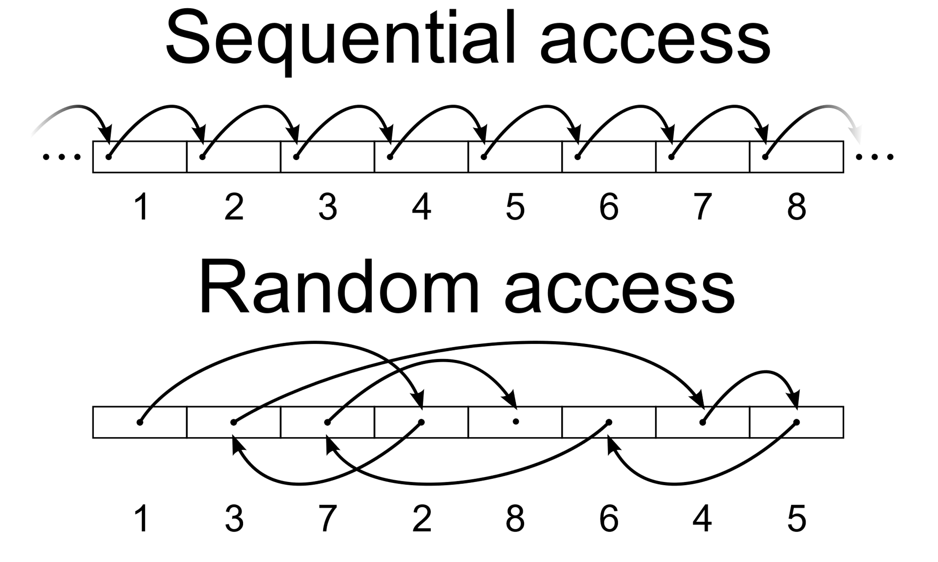
Measuring Storage Performance I/O Patterns, Block Sizes, Read/Write Ratios
Sequential I/O means to access the very next adjacent block in order on the media
Random I/O means to access another block that is not adjacent to current block
IOPS is Input/Output Operations Per Second
An I/O operation is to request a read or write of a certain block size, i.e. 4KB, 256KB
Block size in storage performance is how large of a block is being requested for IOPS
Storage performance is measured by specifying a ratio of sequential to random access patterns, block size, and read/write ratio
i.e. 100% sequential, 0% random, 1KB block size, 100% read, 0% write

Slide 8

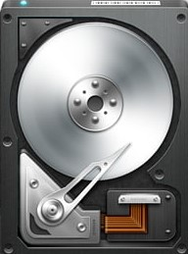
Storage Types
Magnetic
Solid State

Slide 9
Magnetic Storage (HDD)
High capacity (up to 16TB)
Low price (2 cents per gigabyte)
Orders of magnitude lower IOPS performance than SSD
~220MB/sec maximum throughput
~4ms average latency
600 maximum IOPS
Good at sequential I/O, horrible at random I/O

Slide 10
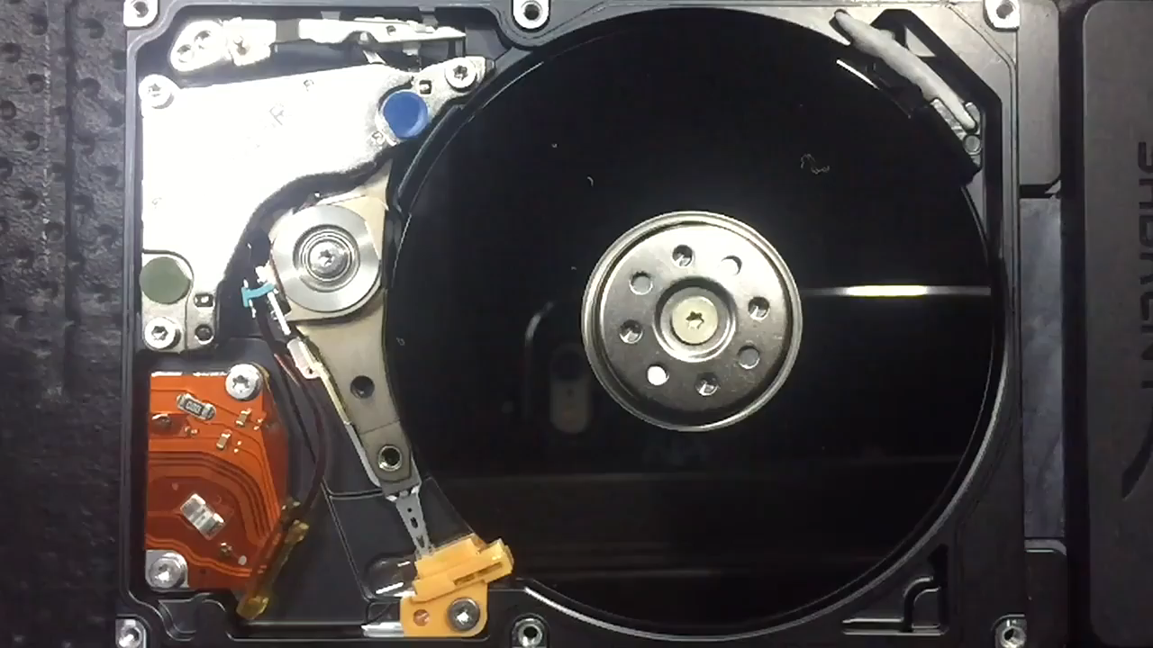
Magnetic Storage Latency

Slide 11
Solid State Storage (SSD)
Medium capacity (commonly up to 2TB)
Higher price (11 cents per gigabyte)
Orders of magnitude higher IOPS performance than HDD
~550MB/sec maximum throughput for SATA
4GB/sec max throughput for NVMe
~20µs average latency
500,000 maximum IOPS
Good for sequential and random I/O

Slide 12
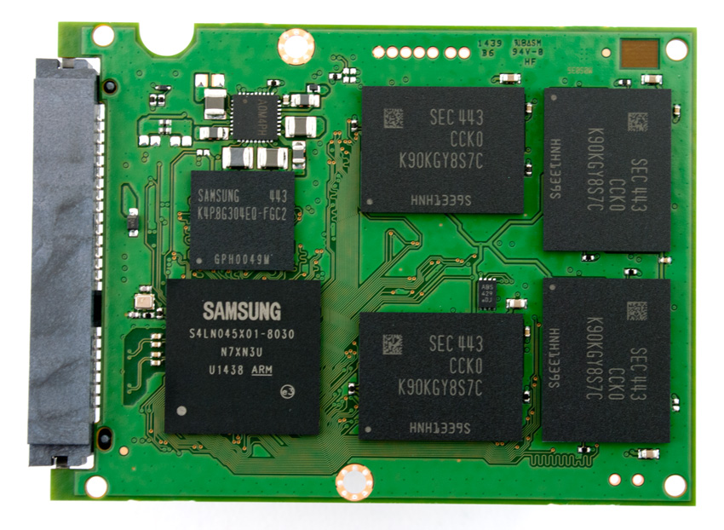
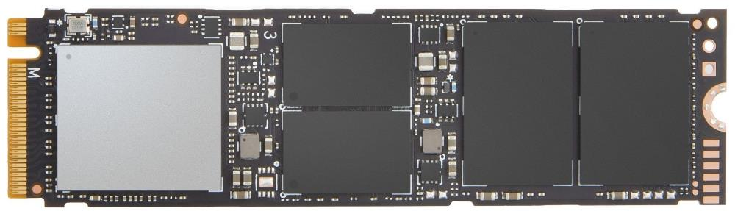
Solid State Storage Latency
2.5 inch SATA SSD with case removed
M.2 NVMe SSD

Slide 13
AWS Storage Options
Block – EBS, EC2 Instance Store, Volume Gateway
File – EFS, FSx for Lustre, FSx for Windows File Server, File Gateway
Object – S3, S3 Glacier, Tape Gateway
Note the icon at the top of each subsequent slide denoting the type of storage for the service
All options are distributed on disks throughout an Availability Zone to prevent data loss due to failure of a single component (except for Instance Store)
All pricing listed is based on the US East (Ohio) region as of a few days ago. Different regions have different prices and they also change over time.

Slide 14
S3 – Simple Storage Service
Flat address space, unlimited storage, accessible via HTTPS REST web services interface
An instance in S3 is called a bucket. Default 100 buckets per AWS account, expandable to 1,000
Folders can be virtual represented by using prefixes like “photos/” or “photos/vacation/”
Accessible via AWS web console, AWS CLI, or programming API. Cannot be directly mounted as a file share (must use File Gateway service for translation)
After AWS CLI installed on your local machine, commands like this used to interact:
aws s3 ls s3://mybucket
aws s3 cp myfolder s3://mybucket/myfolder –recursive
99.9999999% (11 9’s) durability by storing objects on multiple devices in at least 3 AZs

Slide 15
S3 – Simple Storage Service
Storage classes:
S3 Standard has three-AZ availability, writes not returned complete until 2 copies in each AZ completed
S3 Standard-IA (Infrequent Access) is cheaper to store data, but more expensive to retrieve
S3 One Zone-IA is cheaper yet, but lower availability. Same 11 9’s durability
Features:
Cross-region replication for further redundancy, lower latency to other regions – careful with costs
Lifecycle policies can move objects in S3 Standard to IA, One Zone IA, Glacier, or delete based on age
Versioning preserves objects after a PUT, POST, COPY, or DELETE operation. GET always retrieves the latest version. Each version is a full copy and full costs apply. Lifecycle policies can limit versions.
S3 Object Lock enables WORM functionality so objects cannot be deleted by normal processes
Intelligent Tiering automates migration to cheaper storage classes based on access frequency

Slide 16
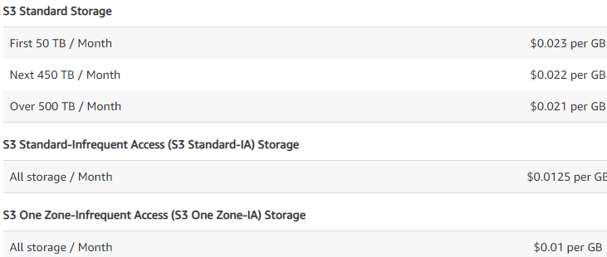
S3 – Simple Storage Service

Slide 17
S3 Glacier
Cost structure made for long-term archives - Very cheap to store, expensive to retrieve
Vaults used instead of buckets – Up to 1,000 vaults per AWS account
Individual objects not stored like S3 Standard, but in archives
Archives can be single files, usually from backup apps or files like ZIP and TAR
Archives are not immediately accessible – three data retrieval options:
Expedited – 1-5 minutes – most expensive option
Standard – 3-5 hours
Bulk – 5-12 hours – least expensive option
Storage - $0.004/GB-month. Retrieval – Expedited $0.03/GB, Standard $0.01/GB, Bulk $0.0025/GB
S3 Glacier Deep Archive – $0.00099/GB-month – for 1-2 times per year retrieval

Slide 18
EBS – Elastic Block Store
Used for EC2 instance storage only
Exists inside a single Availability Zone, but replicated within AZ and designed for 99.999% availability
Volume type, size, and IOPS can be dynamically increased as needed up to volume maximums
Can only be attached to one EC2 instance at a time – no clustering, etc.
SSD or HDD options – different performance, capacity, and costs (
General Purpose SSD – gp2 – $0.10/GB-month
Provisioned IOPS SSD – io1 – $0.125/GB-month + $0.065/provisioned IOPS
Throughput Optimized HDD – st1 – $0.045/GB-month
Cold HDD – sc1 – $0.025/GB-month
Magnetic – standard – $0.05/GB-month + $0.05/1 million IOPS (previous generation – avoid)

Slide 19
EBS – Elastic Block Store
Pay for what you provision, not what you use
Point-in-time snapshots sent to S3 storage for backup, to clone as new EBS volumes, or to move volumes to different Availability Zones
Snapshots incur S3 storage charges - multiple snapshots of same volume incur incrementally
Can remain after EC2 instance is deleted, but take care not to leave clutter
Encryption at rest supported – snapshots taken of encrypted volumes are also encrypted

Slide 20
EC2 Instance Store
Local storage inside the physical server used for temporary data
Data is reset (lost) when instance is stopped or terminated, however, it persists across reboots
NO ADDITIONAL COST – included in EC2 instance price
Usually SSD-based, but some instance types have HDD instance stores
Up to 48TB HDD instance store, 60TB SSD
Good for temporary files like SQL Server tempdb, static web content that is synced during instance startup for auto scaling groups, page file, log files that you don’t need to keep locally

Slide 21
Volume Gateway AWS Storage Gateway service
Hybrid cloud storage service that maintains copies of on-premises files in S3
Stored mode keeps all data on-premises and keeps an EBS snapshots of your data in S3
Off-site disaster recovery without storage array vendor lock-in or third-party replication software
Replicated data storage less expensive than a second storage array
Cached mode keeps only recently used data on-premises but a complete copy in S3
Expand storage footprint without expanding expensive on-premises storage
Deployed as virtual appliance on VMware ESXi, Microsoft Hyper-V, hardware appliance, VMware Cloud on AWS, or in EC2 as an AMI. Volumes mounted from service as iSCSI targets to local hosts
Data encrypted in transit via SSL
EBS snapshots supported for DR or migration to EC2, on-demand compute capacity
Pricing - $0.023 per GB-month plus EBS snapshot storage costs plus outbound transfer to your on-premises gateway or EC2-based gateway (cheaper for EC2-based) – calculator online

Slide 22
EFS – Elastic File System
Managed NFSv4 service for EC2 or on-premises Linux servers via VPN or Direct Connect
Automatic capacity – no need to manage volume size, just add or delete files as needed
Standard and IA (Infrequent Access) storage classes for cost management
EFS Lifecycle Management can automatically move files to IA based on configured policies
Volumes stored in multiple Availability Zones
Thousands of instances can mount the same volume from different AZs, regions, and VPCs
For use anywhere NFSv4 is used – big data, static web content, media, backups, containers, etc.
Will NOT work for Windows Client for NFS – Linux only
Pricing – (calculator online)
Standard Storage - $0.30/GB-month
Infrequent Access Storage - $0.045/GB-month plus access requests $0.01 per GB transferred

Slide 23
FSx for Lustre
Lustre is an open-source parallel file system used in High Performance Computing (HPC)
Lustre name comes from play on Linux + Cluster
Fully managed Lustre service in AWS that provides Lustre client access to existing S3 storage
Spin up and down the service as needed – storage stays in S3
Pricing - $0.14/GB-month, example 7,200GB for 8 hours is $11.20

Slide 24
FSx for Windows File Server
Fully managed Windows file server using SMB 2.0 to 3.1.1
Supports Windows Server 2008, Windows 7 and up, Linux SAMBA clients
Connect from EC2, VMware Cloud on AWS, WorkSpaces, AppStream 2.0, & on-premises clients
Reach via Direct Connect and VPN, from multiple VPCs, accounts and regions via VPC Peering or AWS Transit Gateway
Single file system scales up to 64TB and 2GB/s - use DFS Namespaces to span multiple file systems for more capacity and throughput, DFS Replication for multi-AZ (manual configuration)
Use with AWS Managed Microsoft AD or self-managed AD for authentication
Automatic backups to S3, manual backups as requested
Compatible with Previous Versions feature for self-service restores
No capacity management – only pay for what space you use

Slide 25
File Gateway AWS Storage Gateway service
SMB or NFS access to on-premises gateway service backed by S3, S3 IA, or Glacier
Files cached on gateway service on-premises for low latency access
The same files also accessible via S3 (unlike Volume Gateway)
Gateways can be installed in multiple locations to the same S3 buckets for multi-site access
Files copied to a share at one location become available in S3 and all other locations connected via the File Gateway service
Used for hybrid cloud storage, expanding on-premises storage at a low cost, multi-site replication, backup and recovery, using AWS native services to process data generated on-premises

Slide 26
Tape Gateway AWS Storage Gateway service
Virtual Tape Library (VTL) implementation of Storage Gateway
Compatible with common backup apps like NetBackup, Backup Exec, Veeam, CommVault, etc.
Uses standard iSCSI VTL interface to on-premises gateway service
Backed by S3 Standard, S3 Glacier, or S3 Glacier Deep Archive

Slide 27
AWS Backup
Fully managed backup service in AWS to backup cloud-native services like EFS, EBS, RDS, and DynamoDB or on-premises resources through Storage Gateway
One centralized tool to manage both cloud and on-premises backups with the same schedules and policies
Free service to use – you only pay for the storage you use, but more expensive than S3 native
Pricing - $0.05/GB-month for on-premises - Restores to on-premises via File Gateway are free
Pricing for backups and restores of cloud services differs from on-premises
Interesting alternative to paid on-premises software…

Slide 28
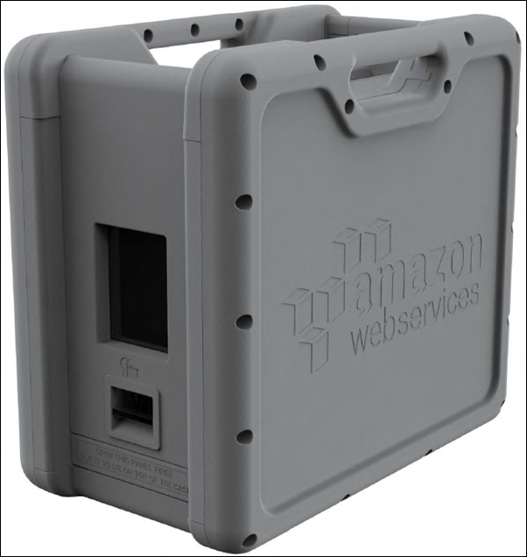
AWS Snowball
Physical device shipped to your datacenter in 50TB and 80TB sizes used for data migration
Ruggedized case with Kindle on front for E-ink interface and shipping label
10Gbit RJ45, SFP+ copper, and SFP+ optical ports on back
Data imported to S3 after shipping to AWS
Pricing - 50TB $200, 80TB $250 for first 10 days. $15 for each extra day.

